Slide 1
Threads and
15
Synchronization

Slide 2
Threads
Strings? Threads?? What are we building… a loom???

Slide 3

Our story so far…
We looked at how processes reproduce with fork()
  This gave us some type of concurrency.
  It is process-level, so the OS is scheduling each task.
We saw some issues with concurrent programming.
  Race conditions mean we have to much more carefully consider our code.
This time…
  We will look at other forms of concurrency.
  Some new methods of coordinating the different sub-programs.
  And some new… dreaded… types of concurrency bugs.

Slide 4

Threads
Process-level concurrency with fork() is powerful, but inflexible.
  The OS schedules the task, incurring context switching overhead.
  The process memory is copied making it hard to share data among tasks.
A thread is a concurrency primitive that is inner-process.
  The program itself schedules the task as part of the same process.
  Process memory, therefore, is shared across all threads.

Slide 5
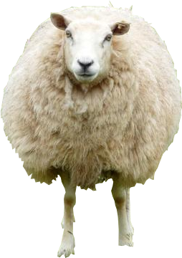
Recall our friend Dolly…
The fork() system call in action:
  Copies the memory layout.
  Copies the process state. (but gives it a unique ID)
Parent
Child
stack
stack
stack
.bss
.bss
.bss
.data
.data
.data
.text
fork()
.text
.text
A
B
CPU State A:
Registers
%FLAGS, %RIP
CPU State A:
Registers
%FLAGS, %RIP
CPU State B:
Registers
%FLAGS, %RIP
PID: 4356
PID: 6567
Page Table A
Page Table B

Slide 6

Dolly learned a new trick!
However, with threads… we retain much of the address space.
  Threads share code/data/etc, however they have their own stack and CPU state.
  They execute in parallel with one another interacting directly with the same data.
Process
.bss
.data
.text
pthread_create()
pthread_create()
stack
stack
stack
A
CPU State A:
Registers
%FLAGS, %RIP
CPU State B:
Registers
%FLAGS, %RIP
CPU State B:
Registers
%FLAGS, %RIP
PID: 4356
Page Table A

Slide 7
libpthread
The 2011 amendment to the C standard (C11) added a threading API.
  However, we will still be looking at an older, more prevalent standard.
We will be reviewing the pthread standard.
  The C11 threads.h API is still very similar.
  There are ports of the pthread.h interface to many OSes.
  Lots of threading APIs in other language emulate it.
Still very useful to learn!

Slide 8

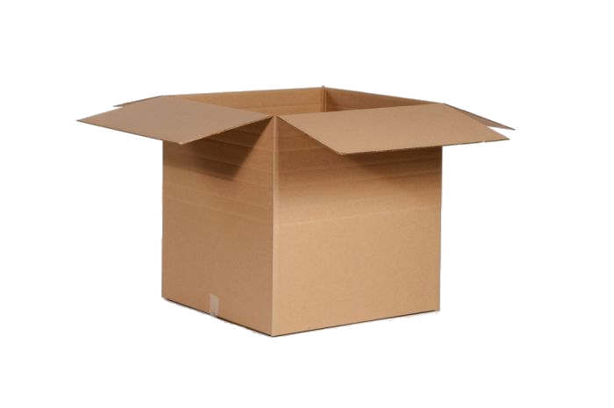


POSIX
The “p” in pthread stands for the Portable Operating System Interface (POSIX).
  This is a standard for creating OS abstractions.
  Intended to lower the burden of porting applications.
    Most OSes conform to most POSIX standards.
    However, very few OSes fully implement POSIX.
POSIX standardizes threads, but also process creation and the behavior of fork, file abstractions, and how data is shared among processes.
  Many OS interfaces are POSIX interfaces and remain (mostly) true across different platforms.

Slide 9
Creating… hmm… no… weaving a thread
C (gcc -o thrd_bad thrd_bad.c -lpthread)
Here is a basic threaded program.
  main() is within the main thread.
The pthread_create function creates a second thread, which runs alongside the main thread.
  The first argument is the address of a variable to hold the thread ID.
  The NULL is where you can add some flags, but the defaults are OK.
  The thread is the function to use.
  The last argument is passed to that function and generally an address.
#include <pthread.h>
#include <stdio.h>
void* thread(void* data) {
printf("Hello, %s!\n", data);
return NULL;
}
void main(void) {
char* str = “students";
pthread_t tid;
pthread_create(&tid, NULL, thread, (void*)str);
printf("Done!\n");
}
This function runs in a thread
Holds the thread ID.
The thread function
Function
argument

Slide 10
The race to the finish.
> ./thrd_bad
Done!
C (gcc -o thrd_bad thrd_bad.c -lpthread)
#include <pthread.h>
#include <stdio.h>
void* thread(void* data) {
printf("Hello, %s!\n", data);
return NULL;
}
void main(void) {
char* str = "wilkie";
pthread_t tid;
pthread_create(&tid, NULL, thread, (void*)str);
printf("Done!\n");
}
However, when the process exits normally, all threads are also canceled, even if they haven’t completed.
In this run, the second thread never prints its message.
This never happens!
In the end of the program, threads are also all exited, potentially prematurely.

Slide 11
Being considerate
> ./thrd
Hello, wilkie!
Done!
C (gcc -o thrd thrd.c -lpthread)
#include <pthread.h>
#include <stdio.h>
void* thread(void* data) {
printf("Hello, %s!\n", (char*)data);
return NULL;
}
void main(void) {
char* str = “students";
pthread_t tid;
pthread_create(&tid, NULL, thread, (void*)str);
pthread_join(tid, NULL); // wait for thread
printf("Done!\n");
}
pthread_join() waits for the given thread to exit by thread ID.
  The NULL is, again, optional flags.
Here, the main thread waits until the thread function completes.
  It prints out the string given by the argument.
The “str” argument.
Waits…
Guaranteed to happen only after thread() completes.

Slide 12
Sharing is caring
C (gcc -o thrd_share_bad thrd_share_bad.c -lpthread)
Unlike process-level concurrency using fork(), threads share memory.
Each thread, here, shares access to the same global variable counter.
  When the main thread updates, the secondary thread sees that value.
Threads share the same virtual address space (and page table.)
  They only have their own stack and CPU state.
#include <pthread.h>
#include <stdio.h>
int counter = 0;
void* thread(void* data) {
while(counter < 100) {
printf("THREAD: %d\n", counter);
counter++;
}
return NULL;
}
void main(void) {
pthread_t tid;
pthread_create(&tid, NULL, thread, NULL);
while(counter < 100) {
printf("MAIN: %d\n", counter);
counter++;
}
printf("Done!\n");
}
Thread function increments
Main thread increments, too!

Slide 13
A problem returns with a vengeance
> ./thrd_share_bad
MAIN: 0
MAIN: 1
MAIN: 2
MAIN: 3
THREAD: 4
THREAD: 5
THREAD: 6
MAIN: 4
MAIN: 8
MAIN: 9
MAIN: 10
THREAD: 7
THREAD: 11
THREAD: 12
C (gcc -o thrd_share_bad thrd_share_bad.c -lpthread)
#include <pthread.h>
#include <stdio.h>
int counter = 0;
void* thread(void* data) {
while(counter < 100) {
printf("THREAD: %d\n", counter);
counter++;
}
return NULL;
}
void main(void) {
pthread_t tid;
pthread_create(&tid, NULL, thread, NULL);
while(counter < 100) {
printf("MAIN: %d\n", counter);
counter++;
}
printf("Done!\n");
}
Thread function might get
interrupted before the print
Then main thread increments! :(
Race Condition

Slide 14
What happened???
C (gcc -o thrd_share_bad thrd_share_bad.c -lpthread)
Since the threads share memory, access to a variable, such as this, may require extra care.
When the main thread gets interrupted just as it was printing the value, the thread is scheduled.
  The thread prints the value instead.
  Then the main thread, when it continues, prints it again!
If only we had a way to… align them in time… what’s the word…
#include <pthread.h>
#include <stdio.h>
int counter = 0;
void* thread(void* data) {
while(counter < 100) {
printf("THREAD: %d\n", counter);
counter++;
}
return NULL;
}
void main(void) {
pthread_t tid;
pthread_create(&tid, NULL, thread, NULL);
while(counter < 100) {
printf("MAIN: %d\n", counter);
counter++;
}
printf("Done!\n");
}
Thread function increments
Main thread increments, too!

Slide 15
Synchronization
You can’t touch this! Stop! Hammer time!

Slide 16
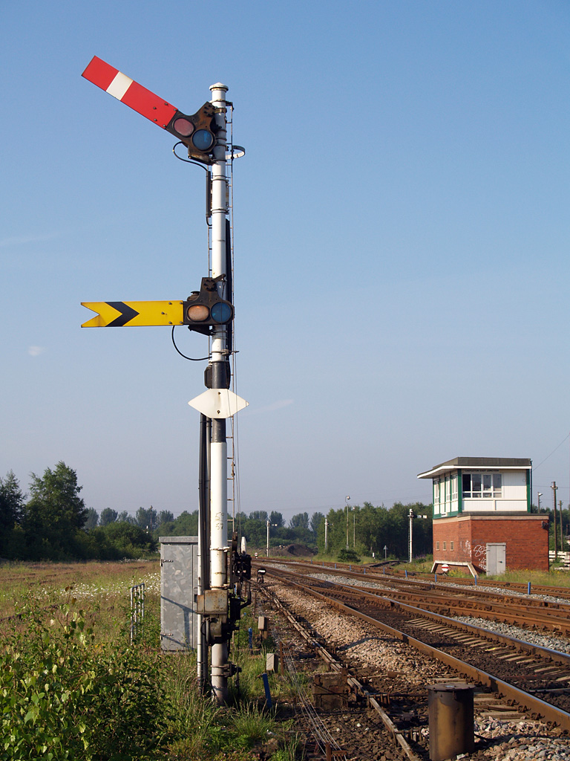
A story about the railroad
Systems scientists have long been inspired by the real-world for insight on design.
The rail system requires a lot of attention to detail to provide:
  Orderly and timely scheduling of trains.
  Shared use of a single resource: rail.
  Coordination with trains and competing interests.
In order to provide this, trains make use of signals and switching areas.
  Trains wait while others pass, all agreeing on the nature of signals.
  The signals are called semaphores.
Photo by David Ingham

Slide 17
The seminal semaphore
A semaphore is a special counter used for synchronization.
  Invented by Dutch systems scientist Edsger Dijkstra in the early 1960s.
The counter is a signed integer that often starts at zero or one.
Two defined operations:
  Up (signal/release); increments counter.
  Down (wait/acquire); decrements counter but waits if the counter is 0.
These operations often have different names or are abbreviated:
  V (Based on Dutch vrijgave “to release”)
  P (Based on Dutch passering “to pass”, based around railroad terminology)

Slide 18
Semaphores to prevent the derailing
sem_init() creates a new semaphore.
  The first argument is an address to a variable that will hold the semaphore data.
  The second argument, when 0, means that other threads can see the semaphore. Non-zero means other threads cannot interact with the semaphore, which is a bit more advanced.
  The third argument is the initial value.
    Here it is 1.
sem_wait() decrements the counter.
  Waits to decrement if the counter is 0.
sem_post() increments the counter.
  May release a thread waiting at sem_wait
C (gcc -o thrd_share thrd_share.c -lpthread)
#include <pthread.h>
#include <semaphore.h>
#include <stdio.h>
sem_t lock;
int counter = 0;
void* thread(void* data) {
while(counter < 100) {
sem_wait(&lock); // down
printf("THREAD: %d\n", counter);
counter++;
sem_post(&lock); // up
}
return NULL;
}
void main(void) {
sem_init(&lock, 0, 1); // create a counter starting at 1
pthread_t tid;
pthread_create(&tid, NULL, thread, NULL);
while(counter < 100) {
sem_wait(&lock); // down
printf("MAIN: %d\n", counter);
counter++;
sem_post(&lock); // up
}
printf("Done!\n");
}
Critical Section

Slide 19
Semaphores to prevent the derailing
C (gcc -o thrd_share thrd_share.c -lpthread)
When both threads hit sem_wait() at the same time, only one continues.
When one sets the lock; other waits.
  The other thread relies on the first to eventually release the lock using sem_post()
  When this happens, the other thread can go.
The lock/unlock pattern creates a critical section, a piece of code that has the guarantee that only one task can enter at a time.
  Here, the counter is guaranteed to update at the same time as it is printed.
#include <pthread.h>
#include <semaphore.h>
#include <stdio.h>
sem_t lock;
int counter = 0;
void* thread(void* data) {
while(counter < 100) {
sem_wait(&lock); // down
printf("THREAD: %d\n", counter);
counter++;
sem_post(&lock); // up
}
return NULL;
}
void main(void) {
sem_init(&lock, 0, 1); // create a counter starting at 1
pthread_t tid;
pthread_create(&tid, NULL, thread, NULL);
while(counter < 100) {
sem_wait(&lock); // down
printf("MAIN: %d\n", counter);
counter++;
sem_post(&lock); // up
}
printf("Done!\n");
}
Critical Section

Slide 20
Semaphores to prevent the derailing
> ./thrd_share
MAIN: 0
MAIN: 1
MAIN: 2
MAIN: 3
THREAD: 4
THREAD: 5
THREAD: 6
MAIN: 7
MAIN: 8
MAIN: 9
MAIN: 10
THREAD: 11
THREAD: 12
THREAD: 13
C (gcc -o thrd_share thrd_share.c -lpthread)
#include <pthread.h>
#include <semaphore.h>
#include <stdio.h>
sem_t lock;
int counter = 0;
void* thread(void* data) {
while(counter < 100) {
sem_wait(&lock); // down
printf("THREAD: %d\n", counter);
counter++;
sem_post(&lock); // up
}
return NULL;
}
void main(void) {
sem_init(&lock, 0, 1); // create a counter starting at 1
pthread_t tid;
pthread_create(&tid, NULL, thread, NULL);
while(counter < 100) {
sem_wait(&lock); // down
printf("MAIN: %d\n", counter);
counter++;
sem_post(&lock); // up
}
printf("Done!\n");
}
Critical Section

Slide 21
Mutex… ew… don’t like the sound of that
As you can see, there is a common case.
  Simple critical sections just need a counter that covers 0 and 1.
A mutex is a special Boolean used for synchronization.
  It is short for “mutual exclusion,” a term for when two things can only have one resource at a time.
There are two defined operations:
  lock / wait; only proceeds if the mutex is unlocked.
  unlock / release; unlocks the mutex.
A mutex can be created using a semaphore.
  It provides a subset of the capabilities of the more general semaphore.

Slide 22
A mutex to prevent the derailing
C (gcc -o thrd_share_mutex thrd_share_mutex.c -lpthread)
Mutexes are useful for locking single resources.
  It follows much the same pattern as semaphores, and perhaps easier to understand.
pthread_mutex_init() creates the mutex similarly to sem_init().
pthread_mutex_lock() and pthread_mutex_unlock() do the locking and unlocking, as expected.
#include <pthread.h>
#include <stdio.h>
pthread_mutex_t lock;
int counter = 0;
void* thread(void* data) {
while(counter < 100) {
pthread_mutex_lock(&lock);
printf("THREAD: %d\n", counter);
counter++;
pthread_mutex_unlock(&lock);
}
return NULL;
}
void main(void) {
pthread_mutex_init(&lock, NULL);
pthread_t tid;
pthread_create(&tid, NULL, thread, NULL);
while(counter < 100) {
pthread_mutex_lock(&lock);
printf("MAIN: %d\n", counter);
counter++;
pthread_mutex_unlock(&lock);
}
printf("Done!\n");
}
Critical Section

Slide 23
A mutex to prevent the derailing
> ./thrd_share_mutex
MAIN: 0
MAIN: 1
MAIN: 2
MAIN: 3
MAIN: 4
THREAD: 5
THREAD: 6
THREAD: 7
THREAD: 8
THREAD: 9
MAIN: 10
MAIN: 11
THREAD: 12
THREAD: 13
C (gcc -o thrd_share_mutex thrd_share_mutex.c -lpthread)
#include <pthread.h>
#include <stdio.h>
pthread_mutex_t lock;
int counter = 0;
void* thread(void* data) {
while(counter < 100) {
pthread_mutex_lock(&lock);
printf("THREAD: %d\n", counter);
counter++;
pthread_mutex_unlock(&lock);
}
return NULL;
}
void main(void) {
pthread_mutex_init(&lock, NULL);
pthread_t tid;
pthread_create(&tid, NULL, thread, NULL);
while(counter < 100) {
pthread_mutex_lock(&lock);
printf("MAIN: %d\n", counter);
counter++;
pthread_mutex_unlock(&lock);
}
printf("Done!\n");
}
Critical Section

Slide 24
Strategies
Semaphores and mutexes are both primitives to aid in concurrent programming.
We saw, here, another example of a race condition, a concurrency bug where the absence of guaranteed order can result in incorrect behavior.
  Namely, threads being interrupted in-between operations that need to happen together and racing another thread that will incorrectly use that intermediate value.
However, that’s not the only type of concurrency bug we can have!
  Yay! ☹

Slide 25
Parallel Pitfalls
This is like that time when a bird pooped on me the same time I stepped in a very muddy puddle.

Slide 26






Everybody loves resources
Resource contention:
Printer needs paper…
You need to buy some paper…
You need to print an order form for paper…
Printer needs paper…

Slide 27

Typically…
Metaphor: intersection.
The intersection is a shared resource, much like a device or the CPU.
Multiplexing the intersection is important to avoid crashes.
When the streets aren’t busy, cars just make it safely across.
It is fine when two
tasks can share a
resource without
conflict… they do
not need to
coordinate.

Slide 28
Deadlock: The traffic jam (it’s not very delicious)
However, in some circumstances, several cars may reach the intersection at the same time.
If there is no previously defined way to handle this, they all wait for the others to get out of the way.
  Forever.
Deadlock occurs when multiple tasks are waiting for each other, making no progress.
Not fine if tasks
need a common
resource at the
same time without
an agreed way to
proceed.

Slide 29
Synchronization solves deadlock
Deadlock is a bug that needs extra consideration to avoid.
In this case, you need some method of making only some of the cars (tasks) wait, while letting others go.
  Traffic light, perhaps
Beyond defining order, synchronization helps avoid these types of logical errors.
With synchronization,
tasks can agree which
get to go next, and
which have to wait.

Slide 30
Starved for attention…
Another issue, related to deadlock, is starvation where the system makes progress but one task is perpetually delayed.
When some tasks have priority over resources, they may not give them up for other tasks.
  Those tasks wait forever.
Without a traffic light, you rely on people being nice. :(
ZZZzzz
When nobody yields
to a particular task
and gives up a shared
resource, that task
cannot proceed!

Slide 31
Starvation: a matter of fairness
This can happen in situations where “fairness” scheduling goes awry.
If you have a webserver, the OS might schedule that process whenever there is some incoming requests.
  What if you are getting a lot of traffic!
  The OS might always schedule the webserver.
  Important background tasks might not run!
Preventing starvation might be keeping track of how much time a process has a resource and how long it has waited in line.
  Low-priority tasks start at the back of the line and move up the queue the longer they wait… eventually cutting in front of high-priority tasks that start in the front.
That’s just one idea. Scheduling resources is a very difficult problem!

Slide 32


Livelock: The hallway problem
There is a narrow hallway.
Let’s say you have two very polite people.
They walk toward each other… and try very hard to get out of each other’s way.
  They keep insisting the other go ahead of them.
This is livelock, where two tasks are actively signaling the other to go and making no progress.

Slide 33
Careful design works around livelock
Livelock can be solved using a tie-breaking scheme.
  Just find something comparable and unique among the tasks to create an arbitrary priority.
All threads have IDs, so one easy strategy is to have the largest ID yield to the smaller.
  This also helps starvation since livelock is starvation to the extreme: where everybody is starving.
42
14

Slide 34
Deadlock vs. Livelock
In deadlock, all tasks are waiting for a signal that will never happen.
  They are inactively achieving nothing. (“ZZZZZZZZ”, “ZZZZZZZZ”)
In contrast, livelock occurs when each task signals the other, and they respond by signaling back. (“No, you.” “No… you!”)
  They are actively achieving nothing.
Detecting that your program has a deadlock or livelock is tricky.
  When it does, it may only happen a small percentage of the time.
  In your OS course, you will learn more about deadlock detection and resolution.

Slide 35
Solving things
Proper synchronization and planning can solve all these issues.
  Deadlock: Avoid patterns of critical sections that depend on each other.
  Livelock: Establish a tie-breaking mechanism (thread with smallest ID goes first!)
  Yet, it takes a good deal of programming experience to handle them.
The wide prevalence of multiprocessing and multithreading capable computers in the hands of average consumers is changing programming.
  New (and old) languages are being pushed for their better handling of concurrency issues.
  Best-practices and frameworks continue to adapt to avoid many of the pitfalls we have discussed today.
  Pay attention in your compilers and OS course to hone your own skill!

Slide 36
pthread basic API summary
#include <pthread.h>
Thread creation
  int pthread_create(pthread_t*, pthread_attr_t*, void*(*)(void*), void*);
Join threads (wait until complete)
  pthread_join(pthread_t, void**); Waits for the given thread to end.
Getting thread ID
  pthread_t pthread_self(); Returns the thread ID of the current thread.
Thread destruction (explicit)
  pthread_cancel(pthread_t); Attempts to preemptively exit the given thread.
  pthread_exit(void*); Ends current thread and returns the provided value.

Slide 37
pthread synchronization API summary
Semaphores
  #include <semaphore.h>
  int sem_init(sem_t*, 0, unsigned int initial_value);
    Creates a semaphore with the given initial value. (The second argument means it the semaphore data is in shared memory. If non-zero, it can’t be seen by other threads.)
  int sem_wait(sem_t*); Decrements counter unless it is 0 in which case it waits.
  int sem_post(sem_t*); Increments counter.
Mutexes
  #include <pthread.h>
  int pthread_mutex_init(pthread_mutex_t, NULL); Creates a mutex (unlocked).
  int pthread_mutex_lock(pthread_mutex_t*); Waits until it can lock the mutex.
  int pthread_mutex_unlock(pthread_mutex_t*); Unlocks the mutex.

Slide 38
Summary
Threads are a different way to provide concurrency in a program.
  Unlike process-level concurrency, threads share memory within the process.
Synchronization primitives such as semaphores allow for creation of critical sections; necessary for correct concurrent code.
Incorrect code may result in a new set of logical errors.
  Race conditions – When execution order stochastically results in wrong behavior.
  Deadlock – When resources are contended so much the program freezes.
  Starvation – When a resource is greedily kept by a task, certain tasks freeze.
  Livelock – Starvation happens at every task… they all actively yield to each other.

